Slide 1

Working with Data
Save & Load Commands
Input Commands (input, menu, questdlg, inputdlg) Output Commands (disp, fprintf, fopen, fclose)
Importing & Exporting Data to Excel
by
First Year Engineering Learning Center
368 Snell Engineering Building
College of Engineering
Northeastern University

Slide 2
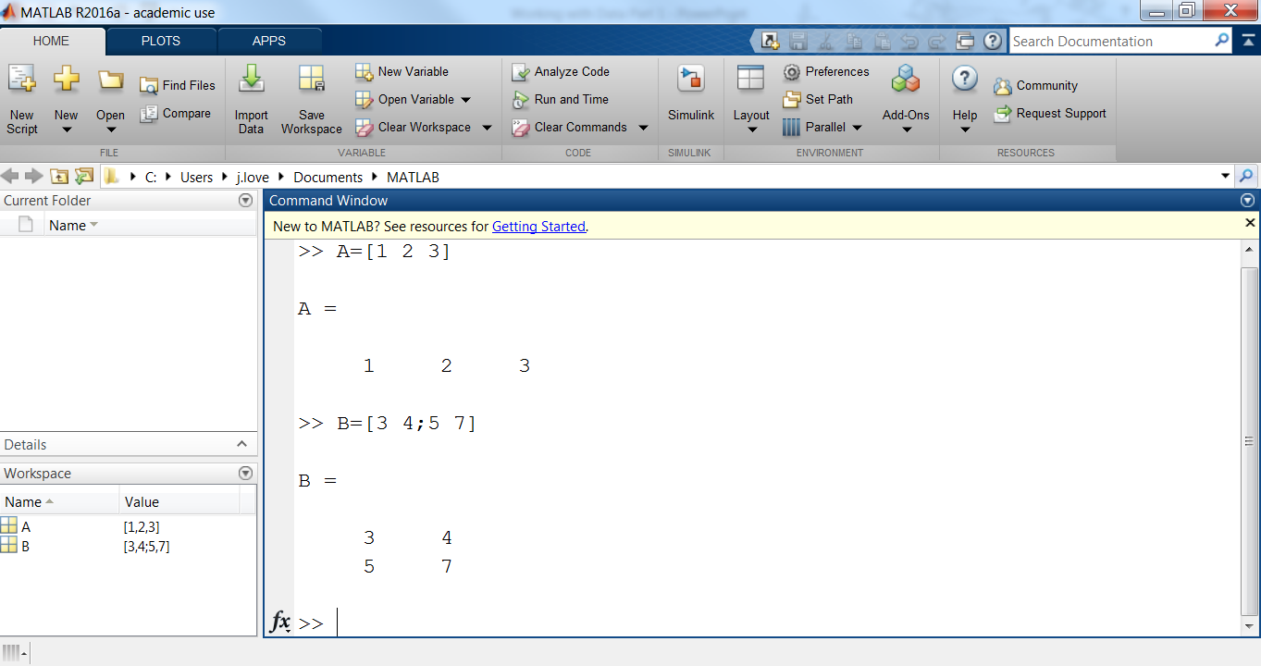
MATLAB Workspace
Variables and array values are defined & stored in Workspace.

Slide 3
Save & Load Commands (.MAT file)
save – used for saving variables and arrays and their values in the current workspace as a .mat file for future use.
load – used to open a saved .mat file from a previous session.
% Create 2 arrays in your Command Window:
>> A=[1 2 3]
>> B=[3 4;5 7]
>> save A_B %creates a file called A_B.mat
>> clear %clear workspace variables
>> load A_B %load A_B.mat file again

Slide 4
Input Commands
Variables can also be defined by user input (input).
% write this script file “calculateBMI.m”
weight=input(‘enter your weight in kg:’)
height=input(‘enter your height in meters:’)
BMI=weight/height^2
>> calculateBMI %run the script file
enter your weight in kg: 50
enter your height in meters: 1.5
BMI = 22.222

Slide 5
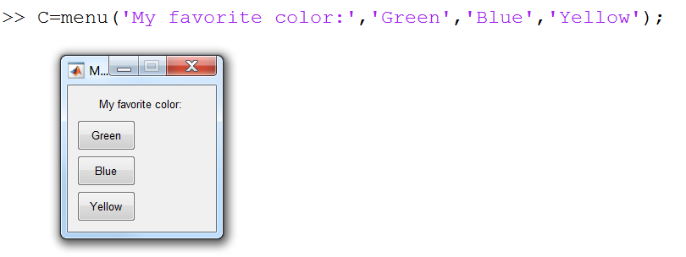
Input Commands
Variables can also be defined by user menu (menu).
% try this line in the Command Window
>> C = menu(‘My favorite color:’,’Green’,’Blue’,’Yellow’);
% user selects answer with cursor
% value Green → C = 1
% value Blue → C = 2
% value Yellow → C = 3

Slide 6
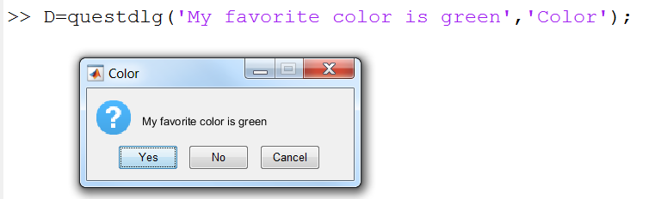
Input Commands
Variables can also be defined by user (questdlg).
% try this line in the Command Window
>> D = questdlg(‘My favorite color is green’,’Color’);
% default answers: Yes, No, Cancel
% user selects answer with cursor
% Yes → D = ‘Yes’
% No → D = ‘No’
% Cancel → D = ‘Cancel’

Slide 7
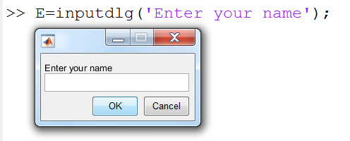
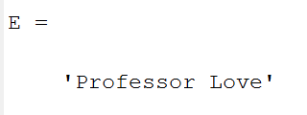
Input Commands
Variables can also be defined by user (inputdlg).
% try this line in the Command Window
>> E = inputdlg(‘Enter your name’);
% user types in string
% E = cell array

Slide 8
Output Commands
display (disp) command – simple, only for display.
>> year = [2012:2017];
>> population = [ 127 130 136 145 158 178];
>> table(:,1) = year’; %transpose year
>> table(:,2) = population’; %transpose pop
>> disp(‘ YEAR POPULATION’)
>> disp(table)

Slide 9
Output Commands (continued)
fprintf command – formatting possible, output multiple variables.
% create new script file “output.m”
fprintf('My name is Love.\n') %new line \n
fprintf('Hello!\n') %new line \n
>> output %in Command Window run script file
My name is Love.
Hello!

Slide 10
Output Commands (continued)
fprintf command – formatting possible, output multiple variables.
fprintf('text %-w.pf more text',variable)
% placeholder for where “variable” will be inserted
- Left justifies (this is called a flag, see textbook for more options)
w width of placeholder space reserved (minimum)
p precision (# of decimal places)
f fixed point (this is the format, see textbook for more options)
% add to existing script file “output.m”
x = 4;
fprintf(‘The number is: %-5.2f \n’,x)
>> run script file in Command Window

Slide 11
Output Commands (continued)
Permission codes
‘r’ is for reading
‘w’ is for writing
‘a’ is for appending file
fprintf command – formatting possible, output multiple variables, save output to file (fopen & fclose).
% create new script file “save_to_file.m”
fid=fopen(‘data.txt’,’w’);%w,write permission
Number = 123;
fprintf(fid,'My name is Professor Love.\n')
fprintf(fid,‘%5.2f \n’,Number)
fprintf(fid,‘Hello!\n')
fclose(fid) >> %open “save_to_file” text file

Slide 12
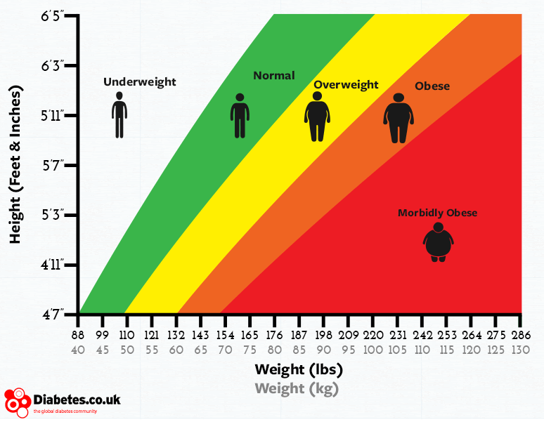
Body Mass Index – Example
% Recall “calculateBMI.m”
>> calculateBMI %run script file & enter #’s
>> save BMI %creates a BMI.mat file
>> clear %clear workspace variables
>> load BMI %load BMI.mat file again
>> f=fopen(‘BMI_data.txt’,’w’); %open file
>>fprintf(f,’%.2f\t%.2f\t%.2f’,weight,height,BMI)
%write data to file & open BMI_data.txt file
>> load BMI_data.txt %load file as 1×3 array
>> fclose(f) %close file

Slide 13
Importing & Exporting Excel Data
xlsread – import an Excel spreadsheet into MATLAB.
variable_name=xlsread('filename’,’sheetname’,’range’)
% create new Excel file “rain_data.xlsx” with time and rain collection by hour (save in current MATLAB working directory) see example
>> raindata=xlsread(‘rain_data.xlsx’)
>> %raindata should now be in your workspace as an array

Slide 14
Importing & Exporting Excel Data
xlswrite – export data to an Excel spreadsheet.
xlswrite('filename’,variable_name)
% continue in the current workspace
>> hours=max(raindata(:,1))%max # of hours
>> rain=sum(raindata(:,2))%sum rain only
>> new_array = [raindata;hours,rain] %create 13x2 array
>> xlswrite(‘new_rain_data.xlsx’,new_array)
%new Excel file should now be in your current folder with the new array

Slide 15
Working with Data
Save & Load Commands
Input Commands (input, menu, questdlg, inputdlg) Output Commands (disp, fprintf, fopen, fclose)
Importing & Exporting Data to Excel
by
First Year Engineering Learning Center
368 Snell Engineering Building
College of Engineering
Northeastern University

